Slide 1


Programming Workshop For Beginners
جلسه دوم
1399 - 1400

Slide 2
send mail
To:
Jaber.babaki94@gmail.com
سلام
دریافت شد
Subject:
session-[session number]-[student number] example: session-02-94131014
ددلاین این دو تا تسک تا فردا شب ۳ آذر هست
jaber
File name: session-[session number]-[student number] example: session-02-94131014.zip
File1: task01
File2:task02
.
.
send

Slide 3
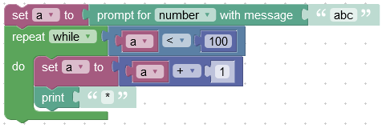
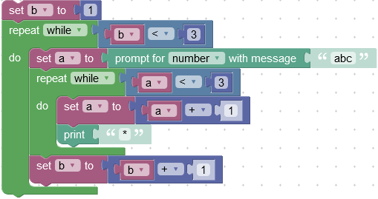
Nested Loop
While ( condition)
staetments
https://blockly-demo.appspot.com/static/demos/code/index.html#uinkcu
While ( condition)
While ( condition)
staetments
https://blockly-demo.appspot.com/static/demos/code/index.html#6icbqr

Slide 4
Digital Clock
23:59:59
00:00:00
00:01:00
1-2-3…….59

Slide 5
Digital Clock
While ( condition)
While ( condition)
While ( condition)
staetments
Task01

Slide 6
Game number
NumFather
کسی که به ۲۱ برسه برنده هست
Rand(1,10)
Rand(1,10)
Rand(1,10)
Rand(1,10)
Rand(1,10)
Rand(1,10)
player

Slide 7
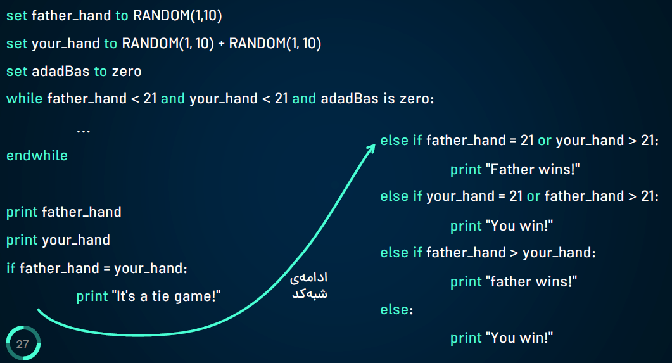
Game number

Slide 8

THANK YOU!
FOR YOUR ATTENTION

